Slide 1
Front END development
Milli K
Saxpros.corp 2024.

Slide 2
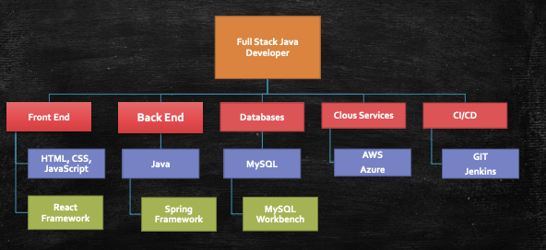
Full Stack Developer: Course Organization

Slide 3


Technical Prerequisites

Slide 4
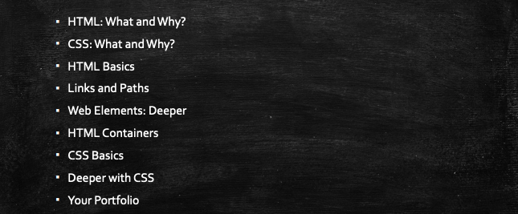
Introduction to HTML & CSS

Slide 5
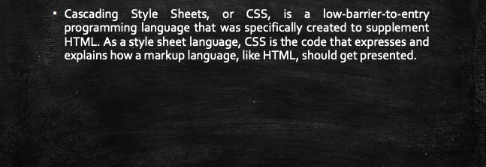
CSS: What and Why?

Slide 6
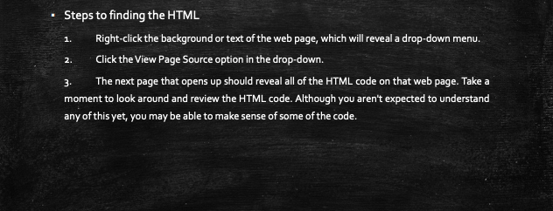
Finding HTML and CSS

Slide 7
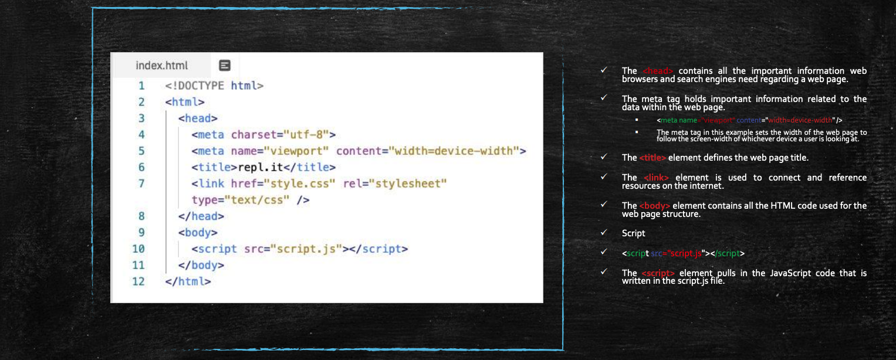
Anatomy of HTML

Slide 8
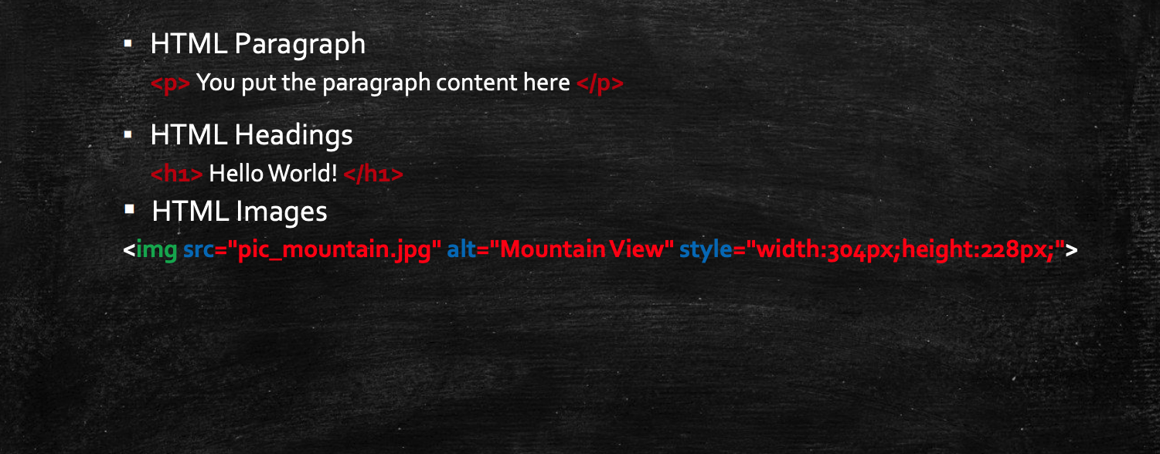
HTML Paragraphs, Headings, and Images

Slide 9
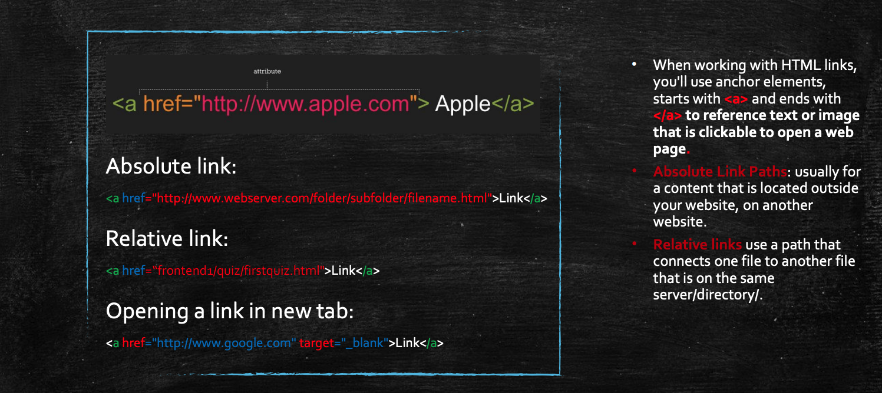
Links and Paths

Slide 10
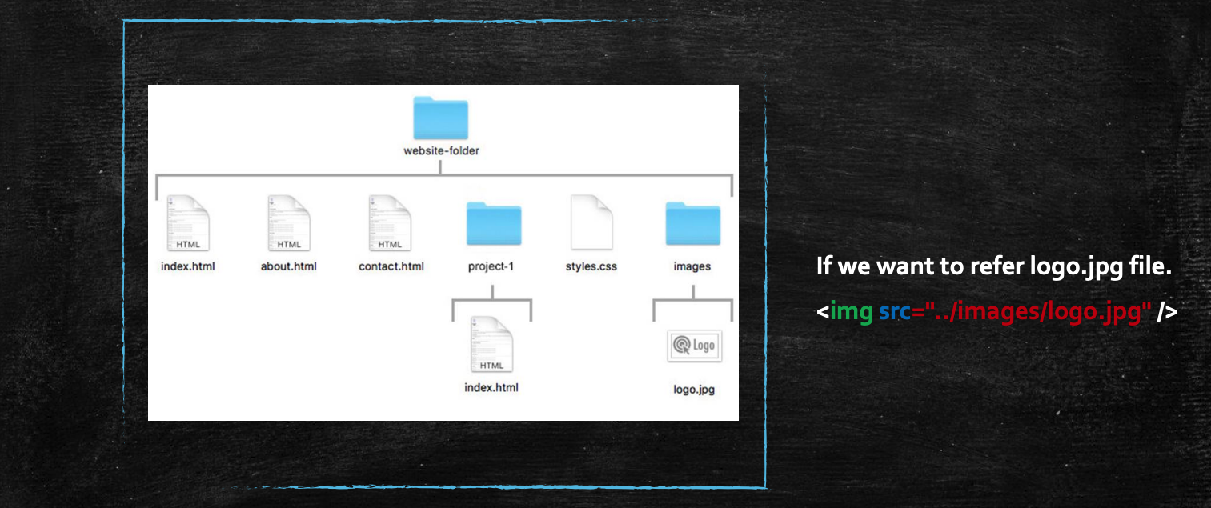
Links and Paths

Slide 11

Exercise

